Slide 1
Cloud Storage for IoT Data
Jenn-Wei Lin
Professor | Fu Jen Catholic University
Notes:
主題名稱
1.中文字型：微軟正黑體
2.英文字型：Calibri
3.大標字體：48
4.下標字體：30
講者姓名
1.講者提供英文姓名＋姓氏
2.格式： title | Advantech | version (從v1.0開始)
3.字型為Calibri 字體為20

Slide 2
1
In this unit, we will focus on the kernel technologies of cloud storage. First, we introduce the cloud file system. The details will be elaborated based on the well-known Hadoop distributed file system (HDFS).
Learning Objectives
2
Next, we will describe the cloud database system how to store cloud structured data based on Google Big Table (GBT). The operations of GBT will be elaborated by step-by-step.
3
Finally, the load balancing mechanisms are given to demonstrate how to efficiently store data in the cloud storage platform with the workload and node heterogenous considerations.
Notes:
本單元學習目標
1.請以1 2 3作為標題編號
2.中文微軟正黑體，英文為Calibri
3.內容字級大小：20

Slide 3
01
Cloud File System
Hadoop Distributed File System(HDFS) Architecture
HDFS Operation
Replication management
Loader Balancer
Outline
02
Cloud Database
BigTable data model
BigTable system architecture
Tablet
Load Balancing

Slide 4
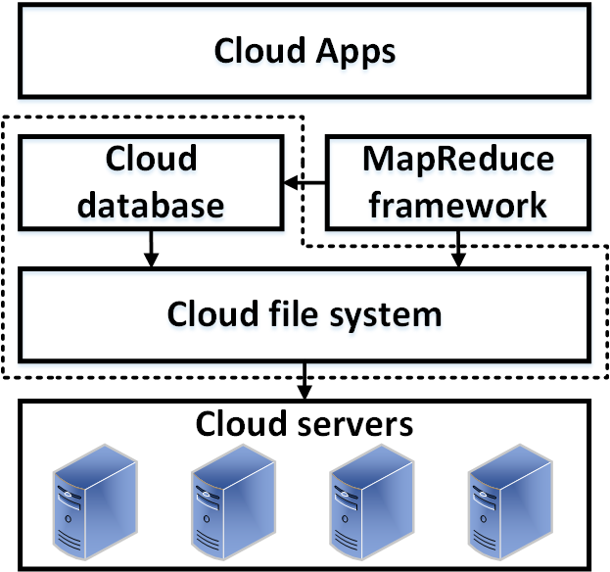
Architecture of Cloud File System
Cloud Apps
Cloud database
Cloud file system
Cloud servers
Notes:
1. 中文微軟正黑體，英文為Calibri
2.標題字級：32置中
3.小標題字級：20
4.內文字級：16
5. 重點可以使用粗體
6.可依需求插入圖片及調整圖片大小
7.每頁皆依上下左右規範留白，規範邊限於編輯完成後即可刪除。

Slide 5
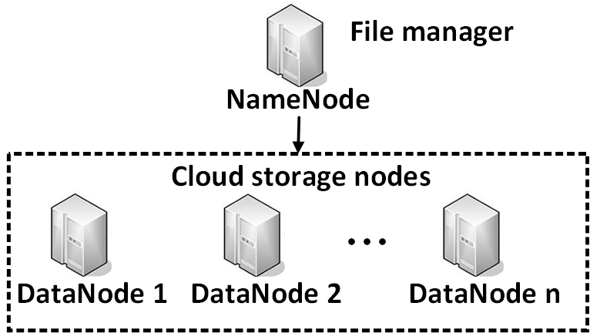
Architecture of Cloud File System
(Hadoop Distributed File System, HDFS)
File
Splitting into blocks
each block with 64M (configurable)
Namenode
Maintaining the location information about the which blocks are stored in which datanodes
Replication management
Datanode
Storing the contents and metadata of blocks
  checksums and generation stamp.
Replication management
Executing cloud applications
Notes:
1. 中文微軟正黑體，英文為Calibri
2.標題字級：32置中
3.小標題字級：20
4.內文字級：16
5. 重點可以使用粗體
6.可依需求插入圖片及調整圖片大小
7.每頁皆依上下左右規範留白，規範邊限於編輯完成後即可刪除。

Slide 6
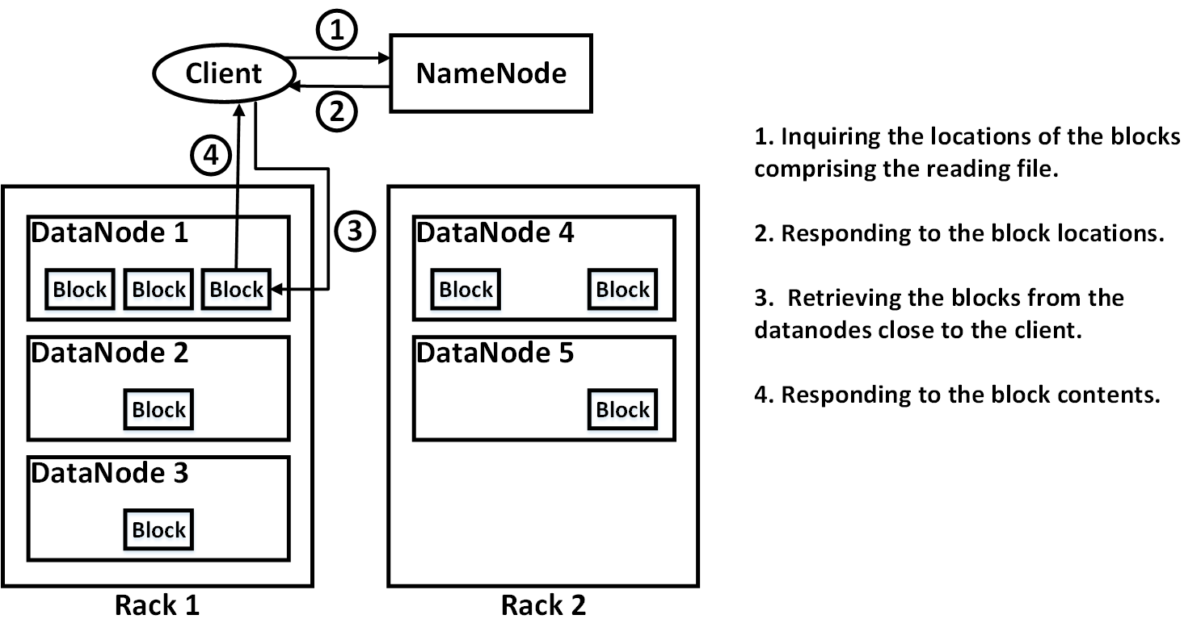
HDFS (Reading data)
Notes:
1. 中文微軟正黑體，英文為Calibri
2.標題字級：32置中
3.小標題字級：20
4.內文字級：16
5. 重點可以使用粗體
6.可依需求插入圖片及調整圖片大小
7.每頁皆依上下左右規範留白，規範邊限於編輯完成後即可刪除。

Slide 7
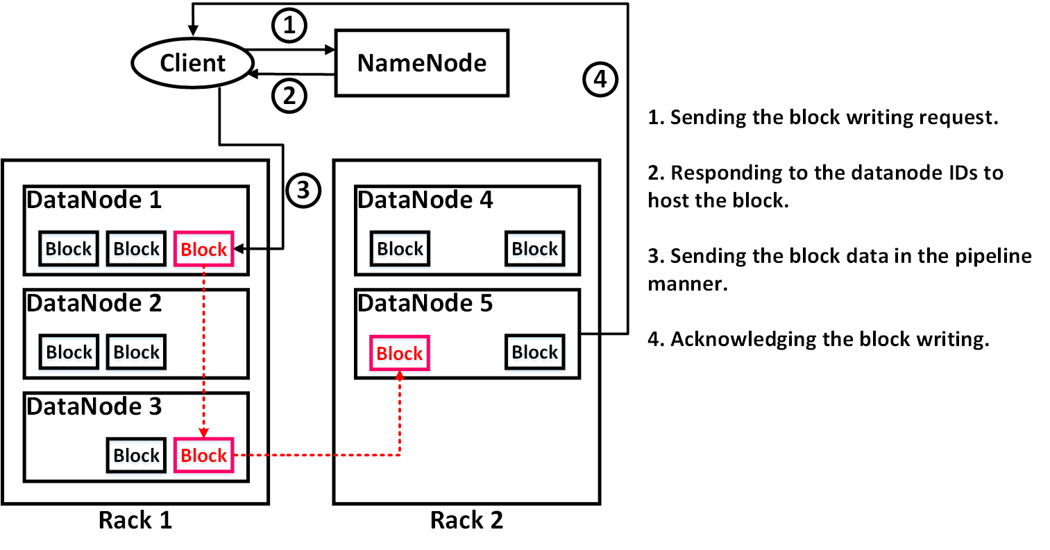
HDFS (Writing data)
Notes:
1. 中文微軟正黑體，英文為Calibri
2.標題字級：32置中
3.小標題字級：20
4.內文字級：16
5. 重點可以使用粗體
6.可依需求插入圖片及調整圖片大小
7.每頁皆依上下左右規範留白，規範邊限於編輯完成後即可刪除。

Slide 8
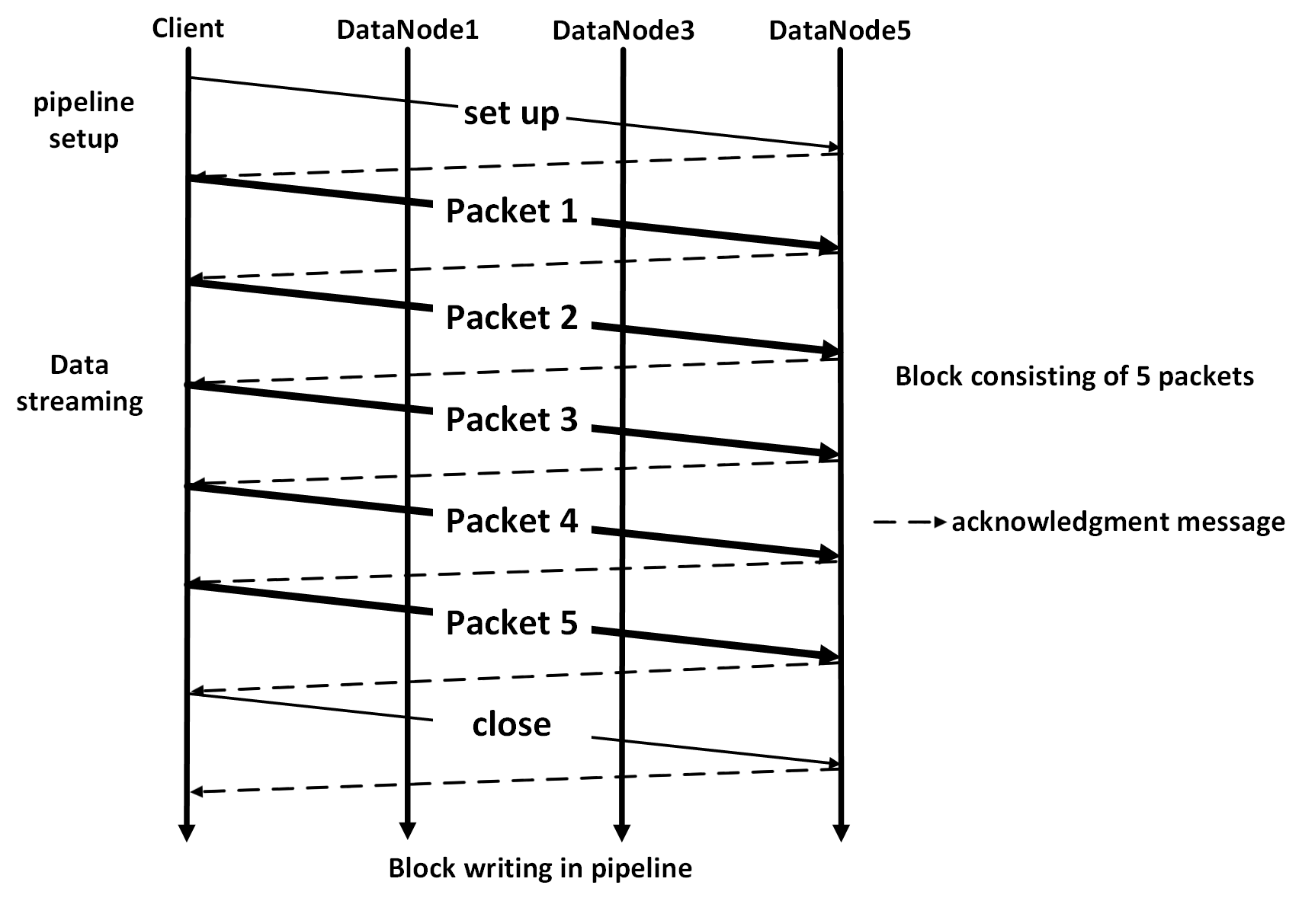
HDFS (Writing data)
Notes:
1. 中文微軟正黑體，英文為Calibri
2.標題字級：32置中
3.小標題字級：20
4.內文字級：16
5. 重點可以使用粗體
6.可依需求插入圖片及調整圖片大小
7.每頁皆依上下左右規範留白，規範邊限於編輯完成後即可刪除。

Slide 9
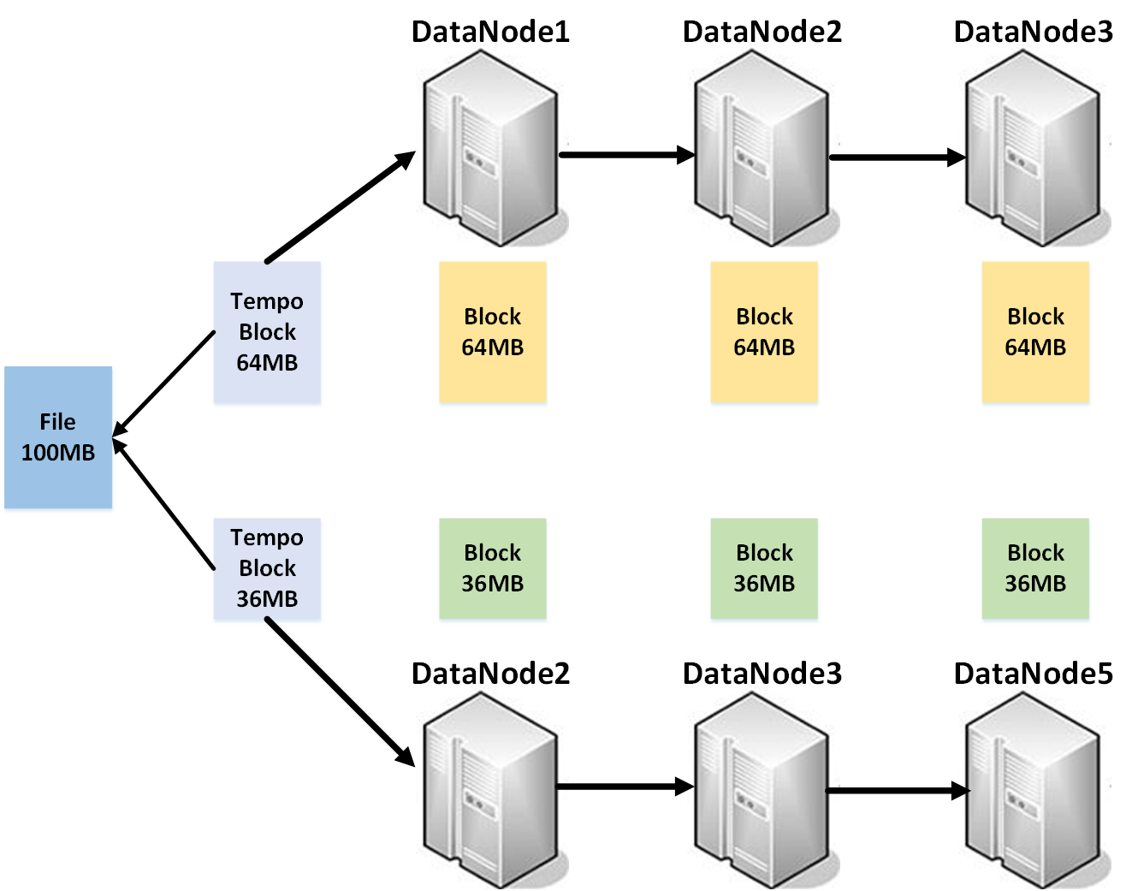
HDFS File Composition
Notes:
1. 中文微軟正黑體，英文為Calibri
2.標題字級：32置中
3.小標題字級：20
4.內文字級：16
5. 重點可以使用粗體
6.可依需求插入圖片及調整圖片大小
7.每頁皆依上下左右規範留白，規範邊限於編輯完成後即可刪除。

Slide 10
Replication management
Block report
Interval: one hour
Block id, the generation stamp, and the block length
Over or under replication based on the block report
Default replicas: three for each block
Heartbeat
Interval: three seconds
Total storage capacity, fraction of storage in use and number of data transfers currently in progress
Not receiving within ten minutes to announce unavailable Datanode
Block replicas lost
Notes:
1. 中文微軟正黑體，英文為Calibri
2.標題字級：32置中
3.小標題字級：20
4.內文字級：16
5. 重點可以使用粗體
6.可依需求插入圖片及調整圖片大小
7.每頁皆依上下左右規範留白，規範邊限於編輯完成後即可刪除。

Slide 11
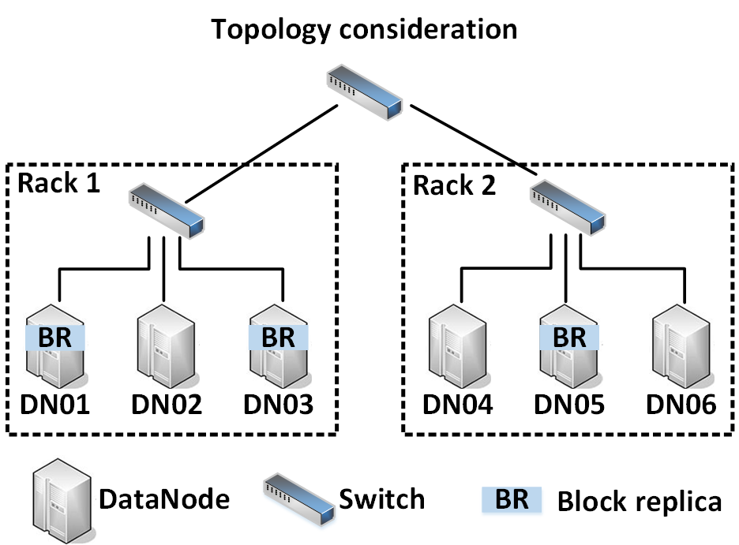
Block replica placement management
Notes:
1. 中文微軟正黑體，英文為Calibri
2.標題字級：32置中
3.小標題字級：20
4.內文字級：16
5. 重點可以使用粗體
6.可依需求插入圖片及調整圖片大小
7.每頁皆依上下左右規範留白，規範邊限於編輯完成後即可刪除。

Slide 12
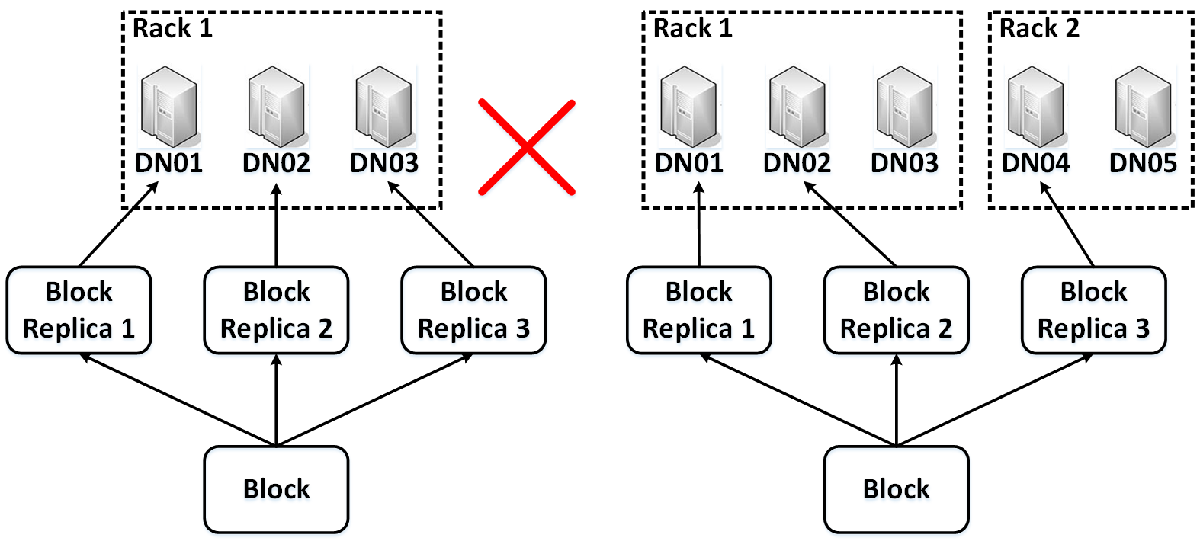
Block replica placement management
One block replica in a datanode.
Most two replicas of a block in a rack.
Notes:
1. 中文微軟正黑體，英文為Calibri
2.標題字級：32置中
3.小標題字級：20
4.內文字級：16
5. 重點可以使用粗體
6.可依需求插入圖片及調整圖片大小
7.每頁皆依上下左右規範留白，規範邊限於編輯完成後即可刪除。

Slide 13
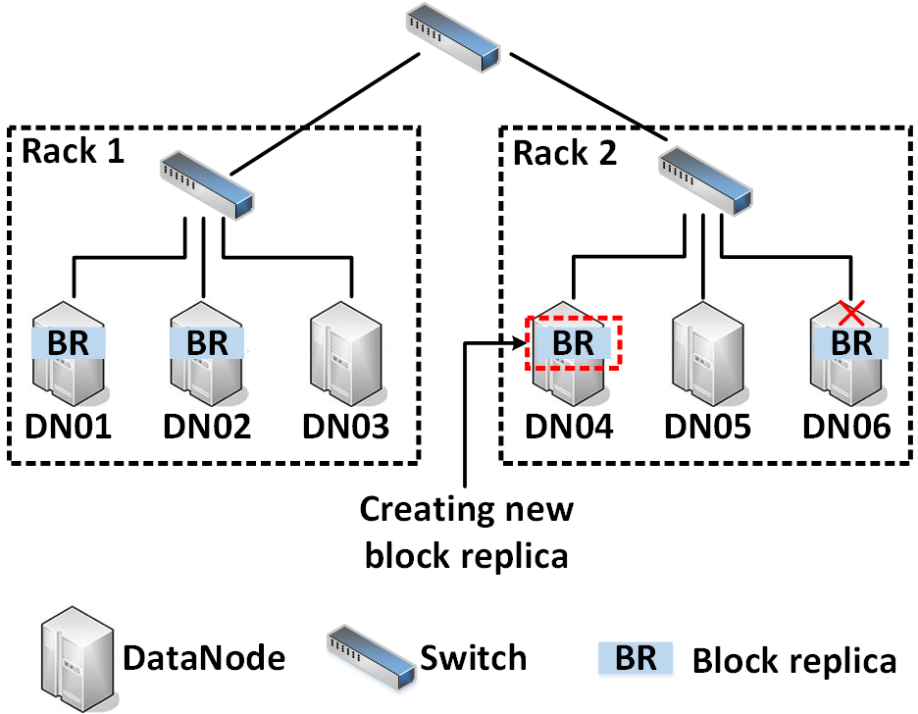
Block under replication
Datanode failure to cause block replica lost
Detecting the under replication occurrence (3 replicas => 2 replicas)
Creating a new block replica without violating the replica placement restriction.
Notes:
1. 中文微軟正黑體，英文為Calibri
2.標題字級：32置中
3.小標題字級：20
4.內文字級：16
5. 重點可以使用粗體
6.可依需求插入圖片及調整圖片大小
7.每頁皆依上下左右規範留白，規範邊限於編輯完成後即可刪除。

Slide 14
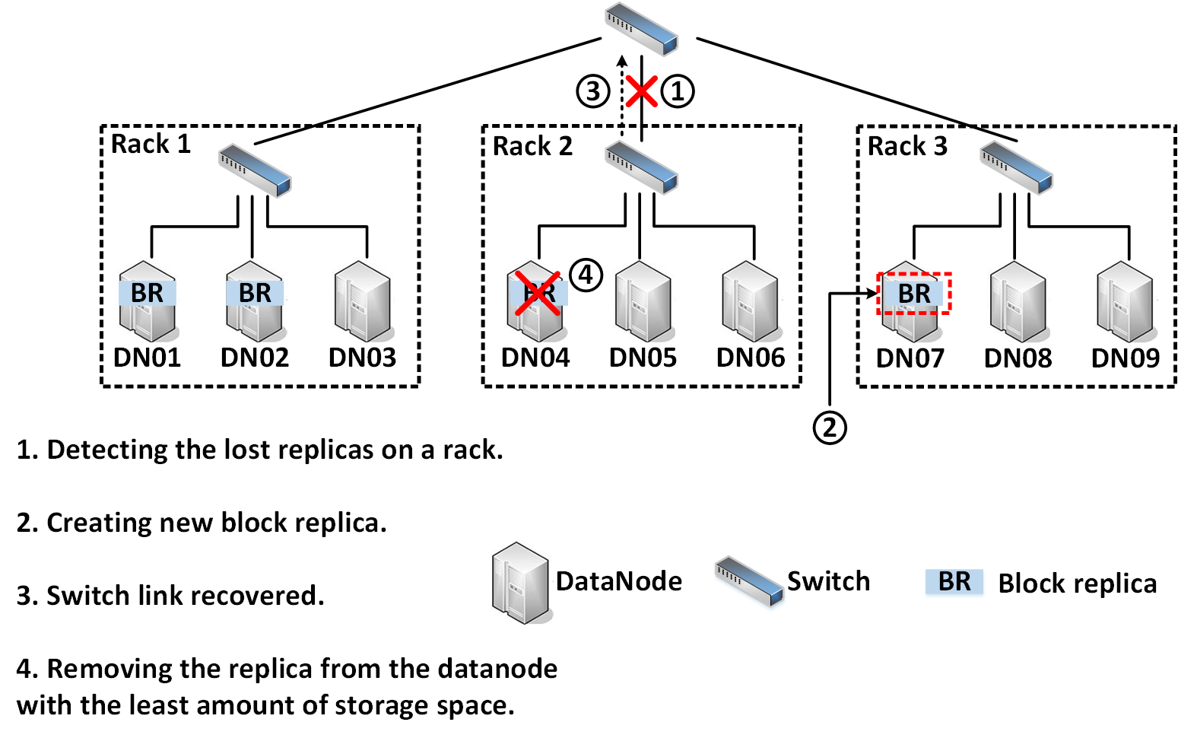
Block over replication
Detecting the lost replicas on a rack and then recovery
  Under replication and then over replication
  (e.g. switch link failure and then recovery)
Not reducing the number of racks with replicas
  Resulting in remove the old replica
Removing the replica from the datanode with the least amount of storage space
Notes:
1. 中文微軟正黑體，英文為Calibri
2.標題字級：32置中
3.小標題字級：20
4.內文字級：16
5. 重點可以使用粗體
6.可依需求插入圖片及調整圖片大小
7.每頁皆依上下左右規範留白，規範邊限於編輯完成後即可刪除。

Slide 15
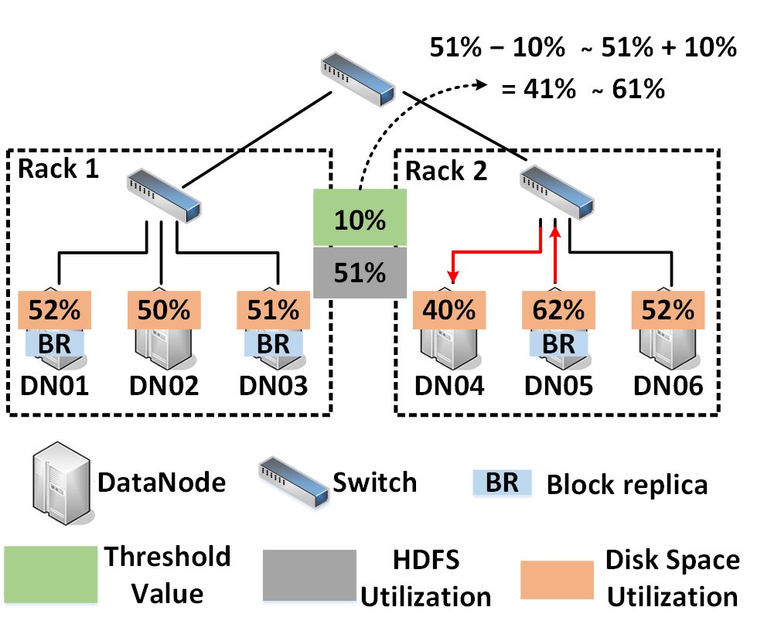
Balancer
Avoid placing data on a small subset of datanodes.
Being placed uniformly across datanodes
Balancing storage space among datanodes
  A threshold in the range of (0,1)
  |The utilization of each datanode - the utilization of whole cluster| <= threshold
  Moving data replicas from the higher-utilization datanodes to the lower-utilization datanodes
  Minimizing the inter-track data transmission
  Not violating the data replica placement strategy
Notes:
1. 中文微軟正黑體，英文為Calibri
2.標題字級：32置中
3.小標題字級：20
4.內文字級：16
5. 重點可以使用粗體
6.可依需求插入圖片及調整圖片大小
7.每頁皆依上下左右規範留白，規範邊限於編輯完成後即可刪除。

Slide 16


QoS-Aware Cloud Data Placement
Hadoop Data Replication
  The QoS requirement of a data-intensive application is not taken into account
    QoS ⬄ data access time of the applications
  Node heterogeneity in the cloud computing system
data replica retrieval time
(4 time units)
QoS violation
expected data access time
(3 time units)
Application
Data block

Slide 17
Problem Definition
QoS-aware data replication (QADR) problem
  Each data block replica is associated with a QoS requirement in terms of the desired access time.
  When data corruption, the node can retrieve the within the desired access time.
  The objectives of QADR problem
    Minimizing the total replication cost of all data blocks
    Minimizing the number of QoS-violated data replicas.
Problem Transformation
  QADR problem => MCMF problem
    Minimum-Cost Maximum Flow
    Well-Known Flow Graph Problem

Slide 18
Example
QADR Scenario
Request nodes: n₃, n₅, n₇, n₉, n₁₀
(r1) (r2) (r3) (r4) (r5)

Slide 19
Example
Graph Modeling (MCMF Graph)
(Flow capacity, Flow cost)
Flow edge
Flow edge

Slide 20
01
Cloud File System
Hadoop Distributed File System(HDFS)
HDFS Operation
Replication management
Placement management
Balancer
簡報大綱
02
Cloud Database
BigTable data model
BigTable system architecture
Load Balancing
Notes:
簡報大綱
1.列出單元及各小節名稱
2.請以01.02.03作為標題編號
3.大標大小30，粗體， 顏色：黑
4.自標題大小18，顏色： 黑
5.中文微軟正黑體，英文為Calibri
老師可依需求增減介紹項目，若一頁不夠可新增下一頁。

Slide 21
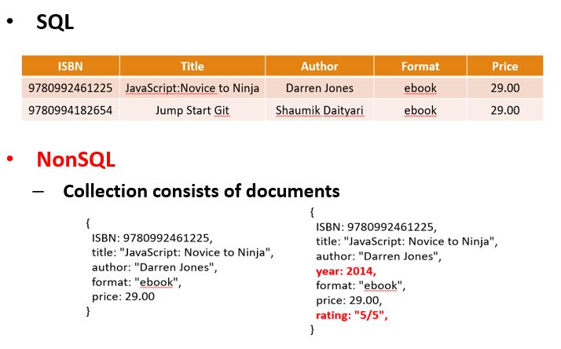
Cloud Database
SQL v.s. NonSQL
SQL (Structure Query Language)
MySQL, PostgreSQL, SQLite, etc.
NonSQL (Not only SQL)
MongoDB, CouchDB, Cassandra, Hbase, BigTable, etc.
Notes:
1. 中文微軟正黑體，英文為Calibri
2.標題字級：32置中
3.小標題字級：20
4.內文字級：16
5. 重點可以使用粗體
6.可依需求插入圖片及調整圖片大小
7.每頁皆依上下左右規範留白，規範邊限於編輯完成後即可刪除。

Slide 22
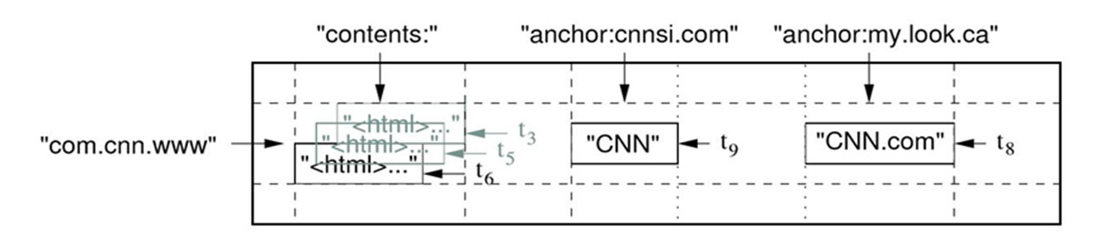
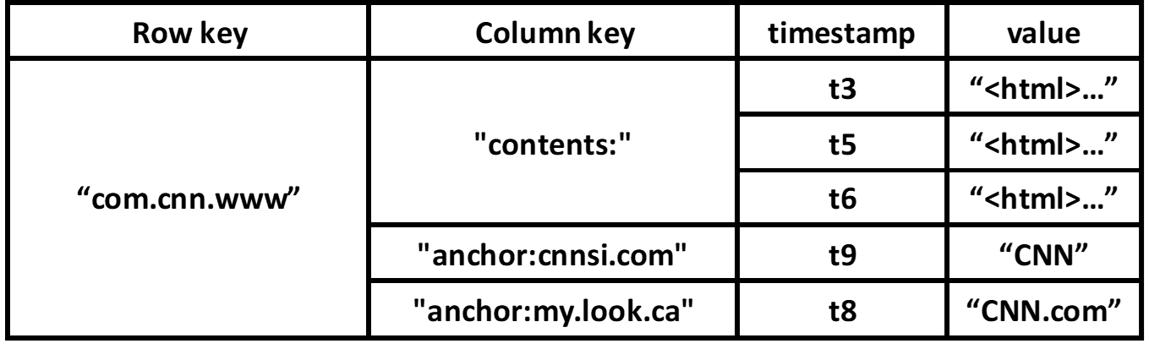
BigTable data model
Row key: “com.cnn.www”
Column families (column keys with the same type): “contents” and "anchor“
  Anchors=> two column qualifier : “ cnnsi.com” and “ my.look.ca” (the names of referring sites) => two column keys: “anchor:cnnsi.com” and “anchor:my.look.ca” => the contents of two cells: “CNN” and “CNN.com” hyperlink
Timestamp: multiple versions of data in a cell
Notes:
1. 中文微軟正黑體，英文為Calibri
2.標題字級：32置中
3.小標題字級：20
4.內文字級：16
5. 重點可以使用粗體
6.可依需求插入圖片及調整圖片大小
7.每頁皆依上下左右規範留白，規範邊限於編輯完成後即可刪除。

Slide 23
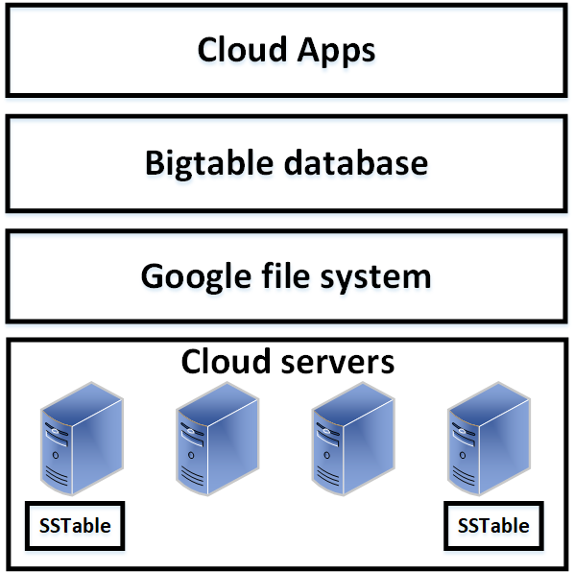
BigTable system architecture
Distributed database among a number of commodity servers
Log and data via GFS (Google File System) to servers
GFS data => SSTable file format => server storage
Chubby (Persistent distributed lock service) maintains the consistency of Bigtable.
Notes:
1. 中文微軟正黑體，英文為Calibri
2.標題字級：32置中
3.小標題字級：20
4.內文字級：16
5. 重點可以使用粗體
6.可依需求插入圖片及調整圖片大小
7.每頁皆依上下左右規範留白，規範邊限於編輯完成後即可刪除。

Slide 24
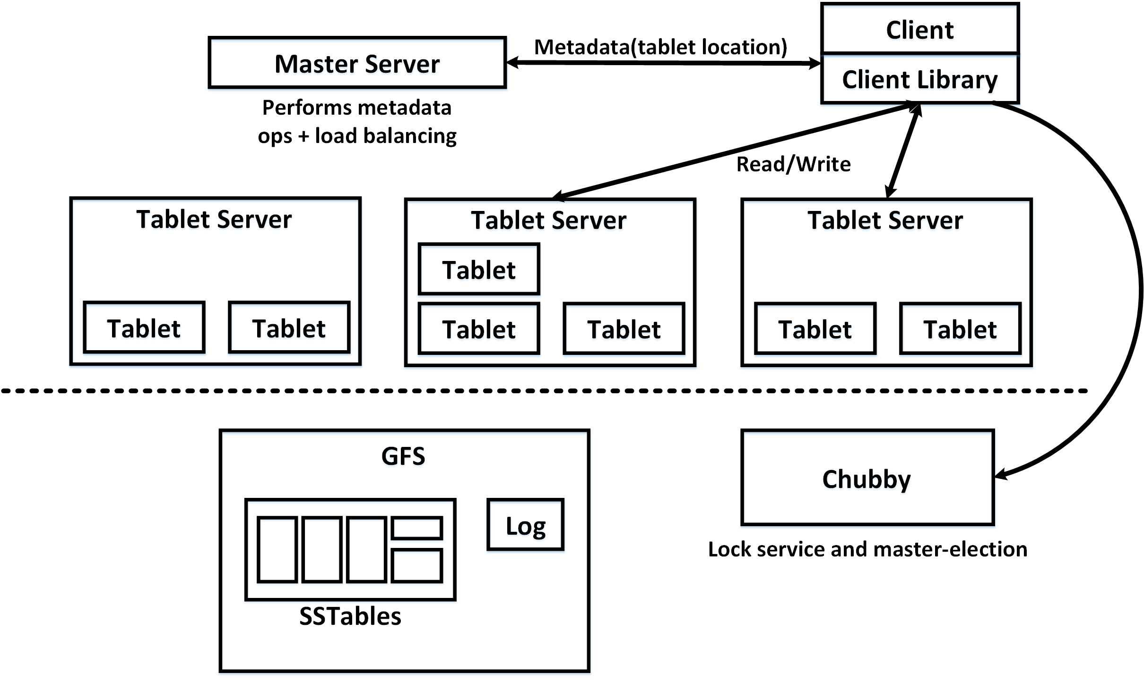
BigTable system architecture
Notes:
1. 中文微軟正黑體，英文為Calibri
2.標題字級：32置中
3.小標題字級：20
4.內文字級：16
5. 重點可以使用粗體
6.可依需求插入圖片及調整圖片大小
7.每頁皆依上下左右規範留白，規範邊限於編輯完成後即可刪除。

Slide 25
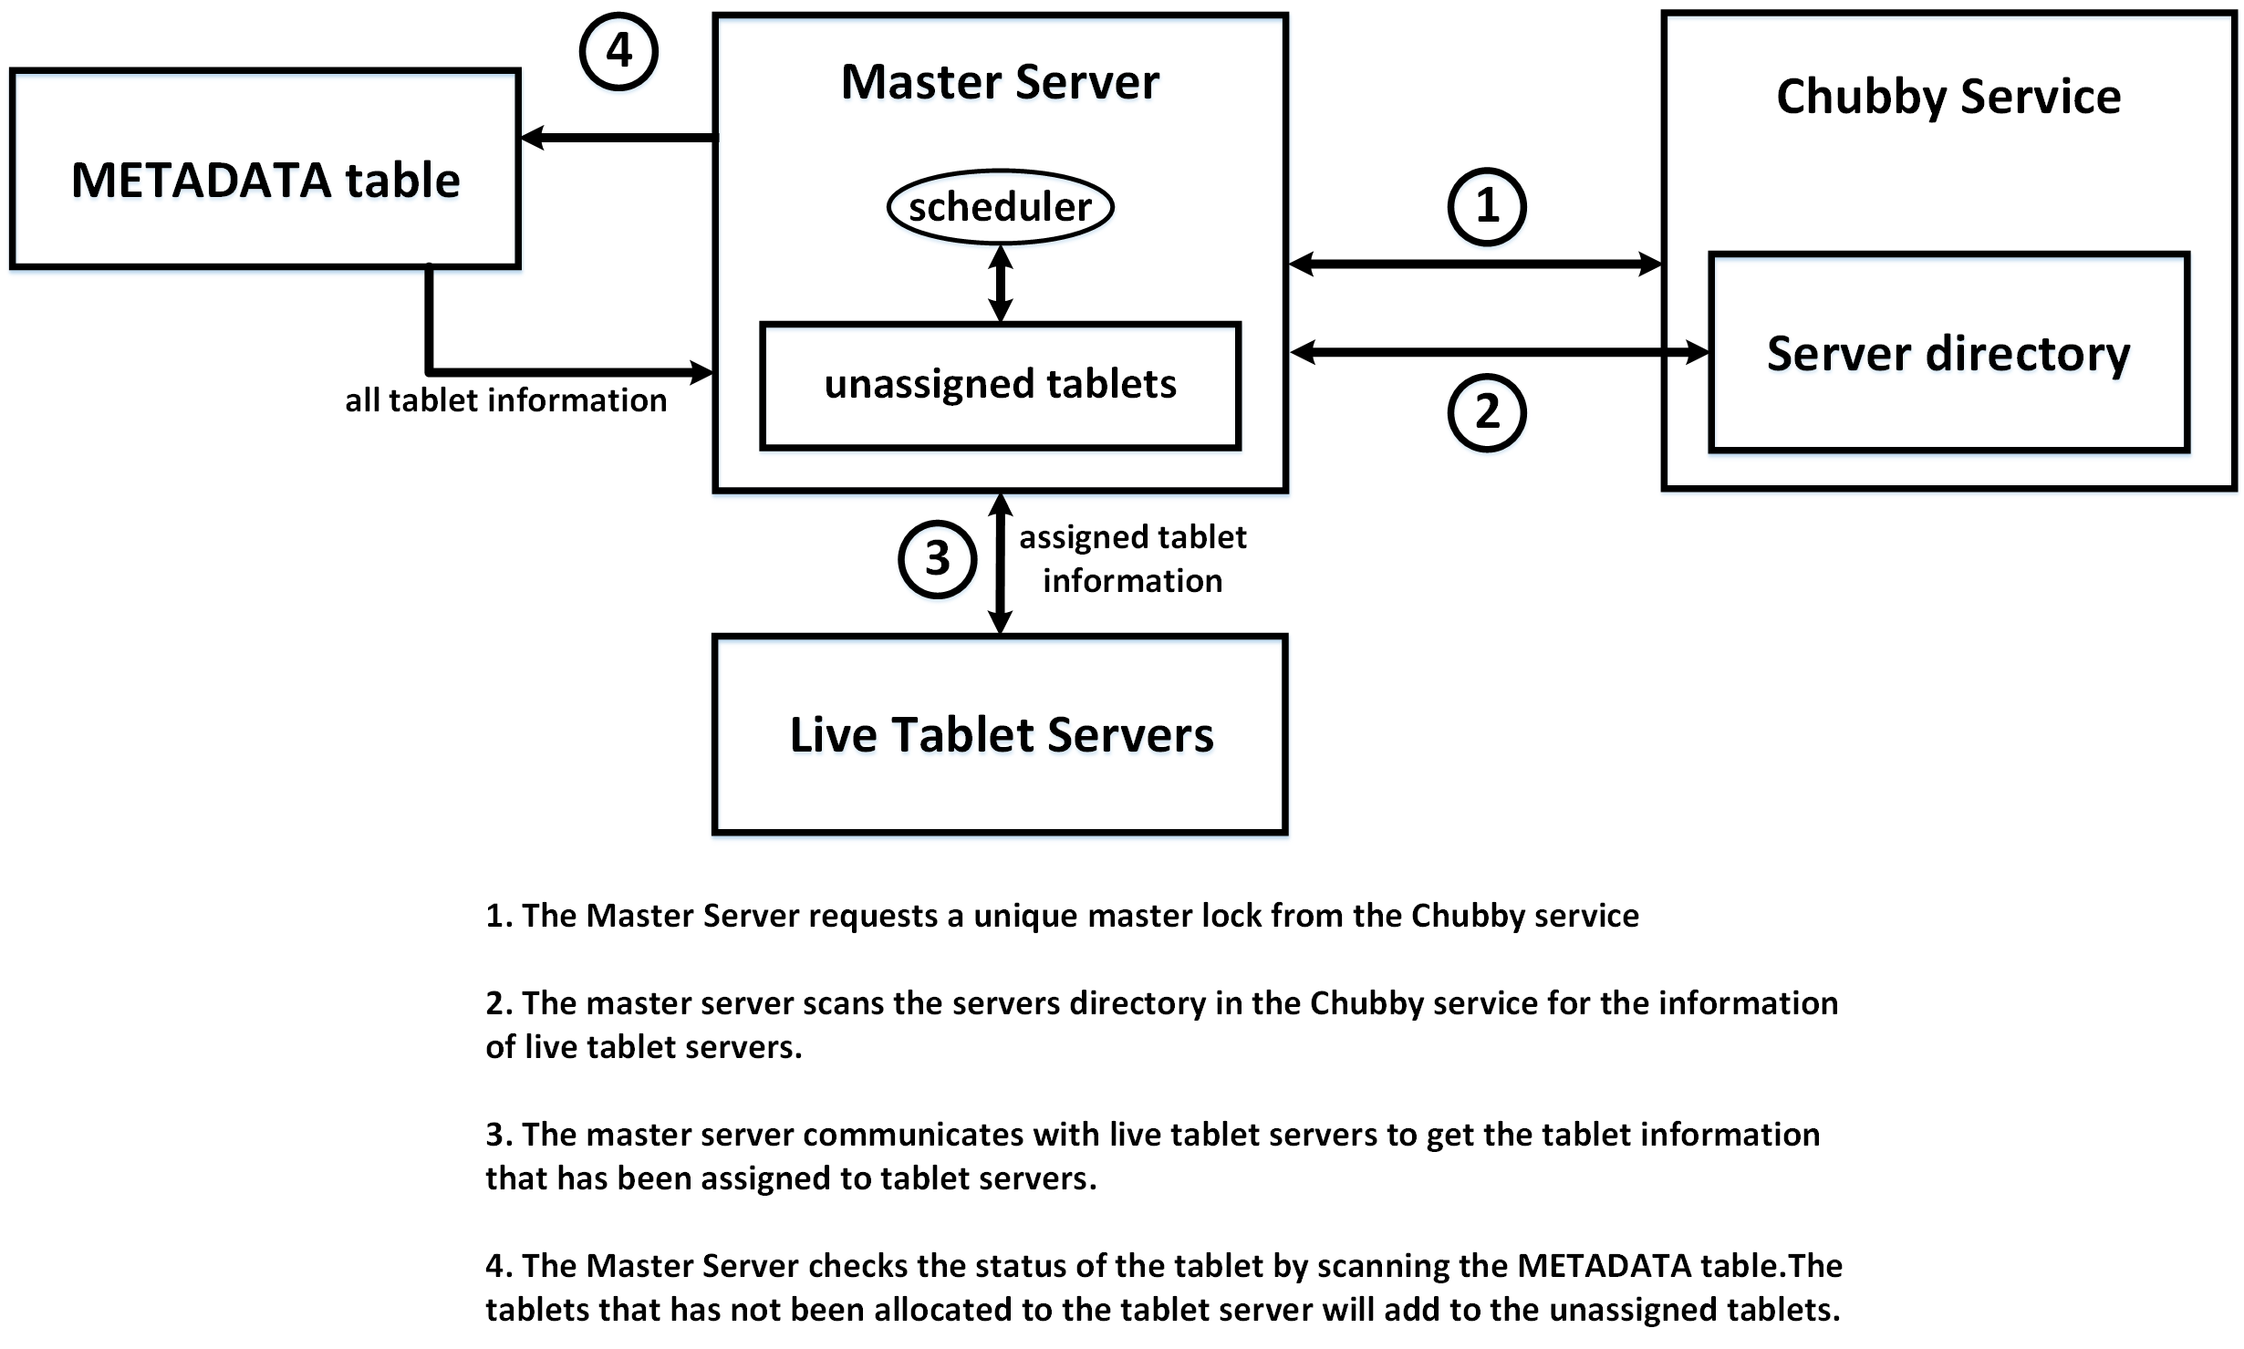
Master Server and Chubby
Notes:
1. 中文微軟正黑體，英文為Calibri
2.標題字級：32置中
3.小標題字級：20
4.內文字級：16
5. 重點可以使用粗體
6.可依需求插入圖片及調整圖片大小
7.每頁皆依上下左右規範留白，規範邊限於編輯完成後即可刪除。

Slide 26
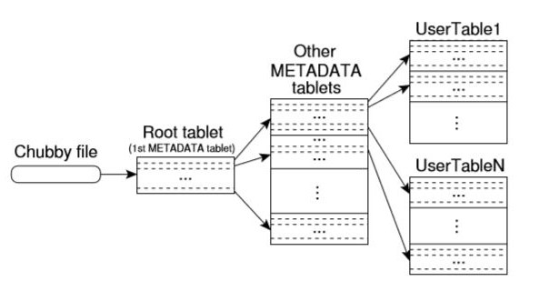
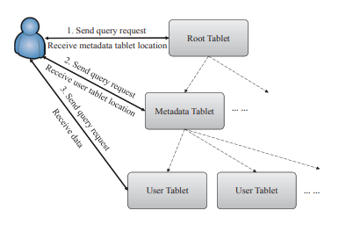
Tablet
Tablet Location
Three-level hierarchy
Tablet server
Storing one or more tablets and table splitting
  Tablet size in 100-200 MB
Handling tablet reading and writing requests
Data in tablet server
  Key-column pair values
Notes:
1. 中文微軟正黑體，英文為Calibri
2.標題字級：32置中
3.小標題字級：20
4.內文字級：16
5. 重點可以使用粗體
6.可依需求插入圖片及調整圖片大小
7.每頁皆依上下左右規範留白，規範邊限於編輯完成後即可刪除。

Slide 27
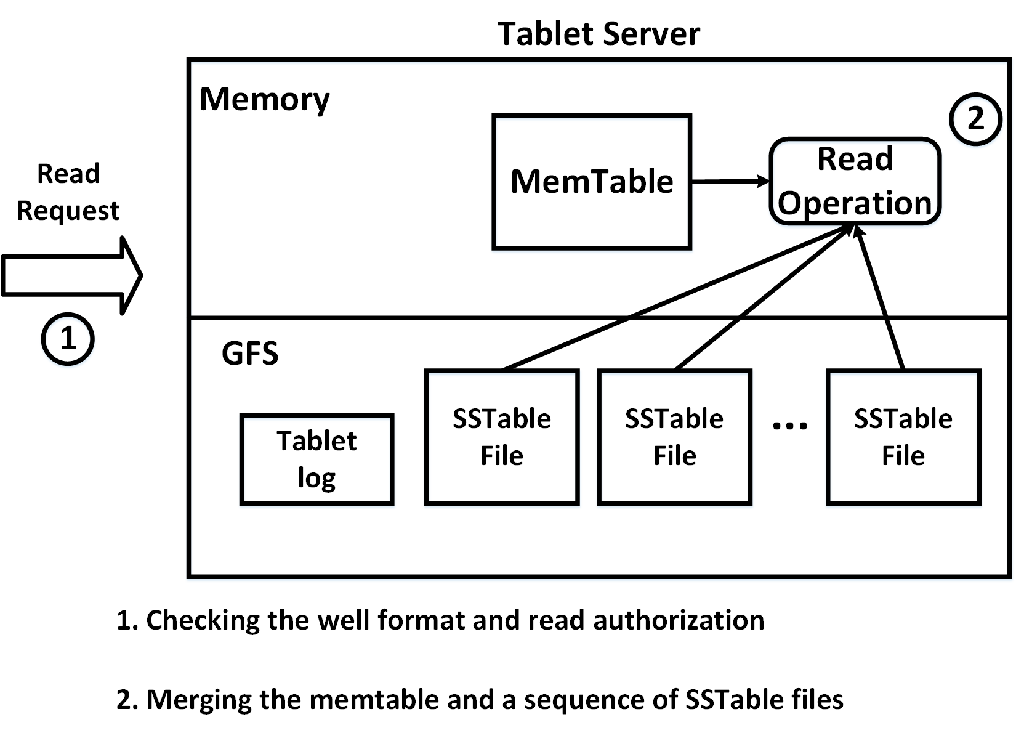
Tablet data reading
Notes:
1. 中文微軟正黑體，英文為Calibri
2.標題字級：32置中
3.小標題字級：20
4.內文字級：16
5. 重點可以使用粗體
6.可依需求插入圖片及調整圖片大小
7.每頁皆依上下左右規範留白，規範邊限於編輯完成後即可刪除。

Slide 28
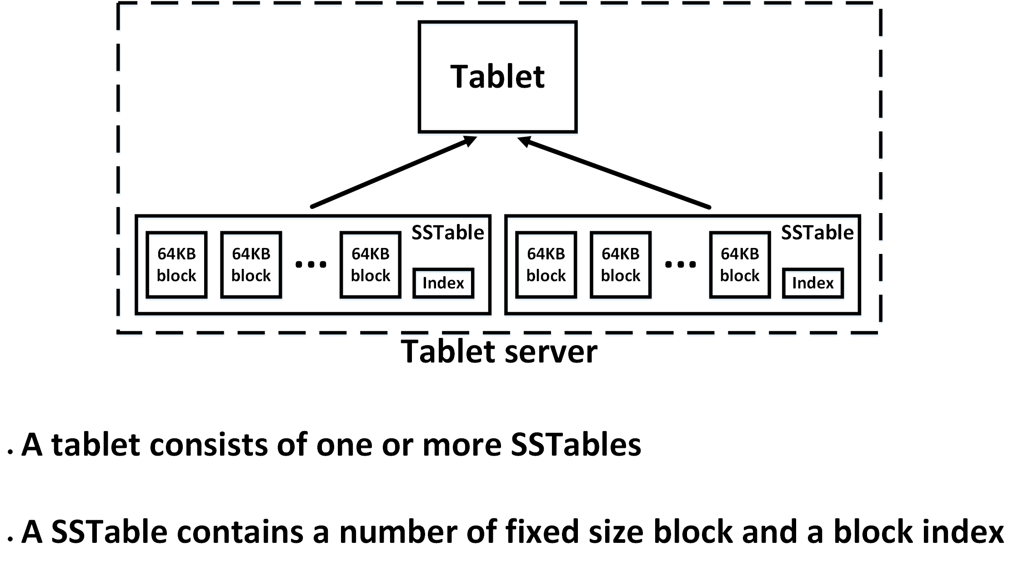
SSTable in Tablet server
Notes:
1. 中文微軟正黑體，英文為Calibri
2.標題字級：32置中
3.小標題字級：20
4.內文字級：16
5. 重點可以使用粗體
6.可依需求插入圖片及調整圖片大小
7.每頁皆依上下左右規範留白，規範邊限於編輯完成後即可刪除。

Slide 29
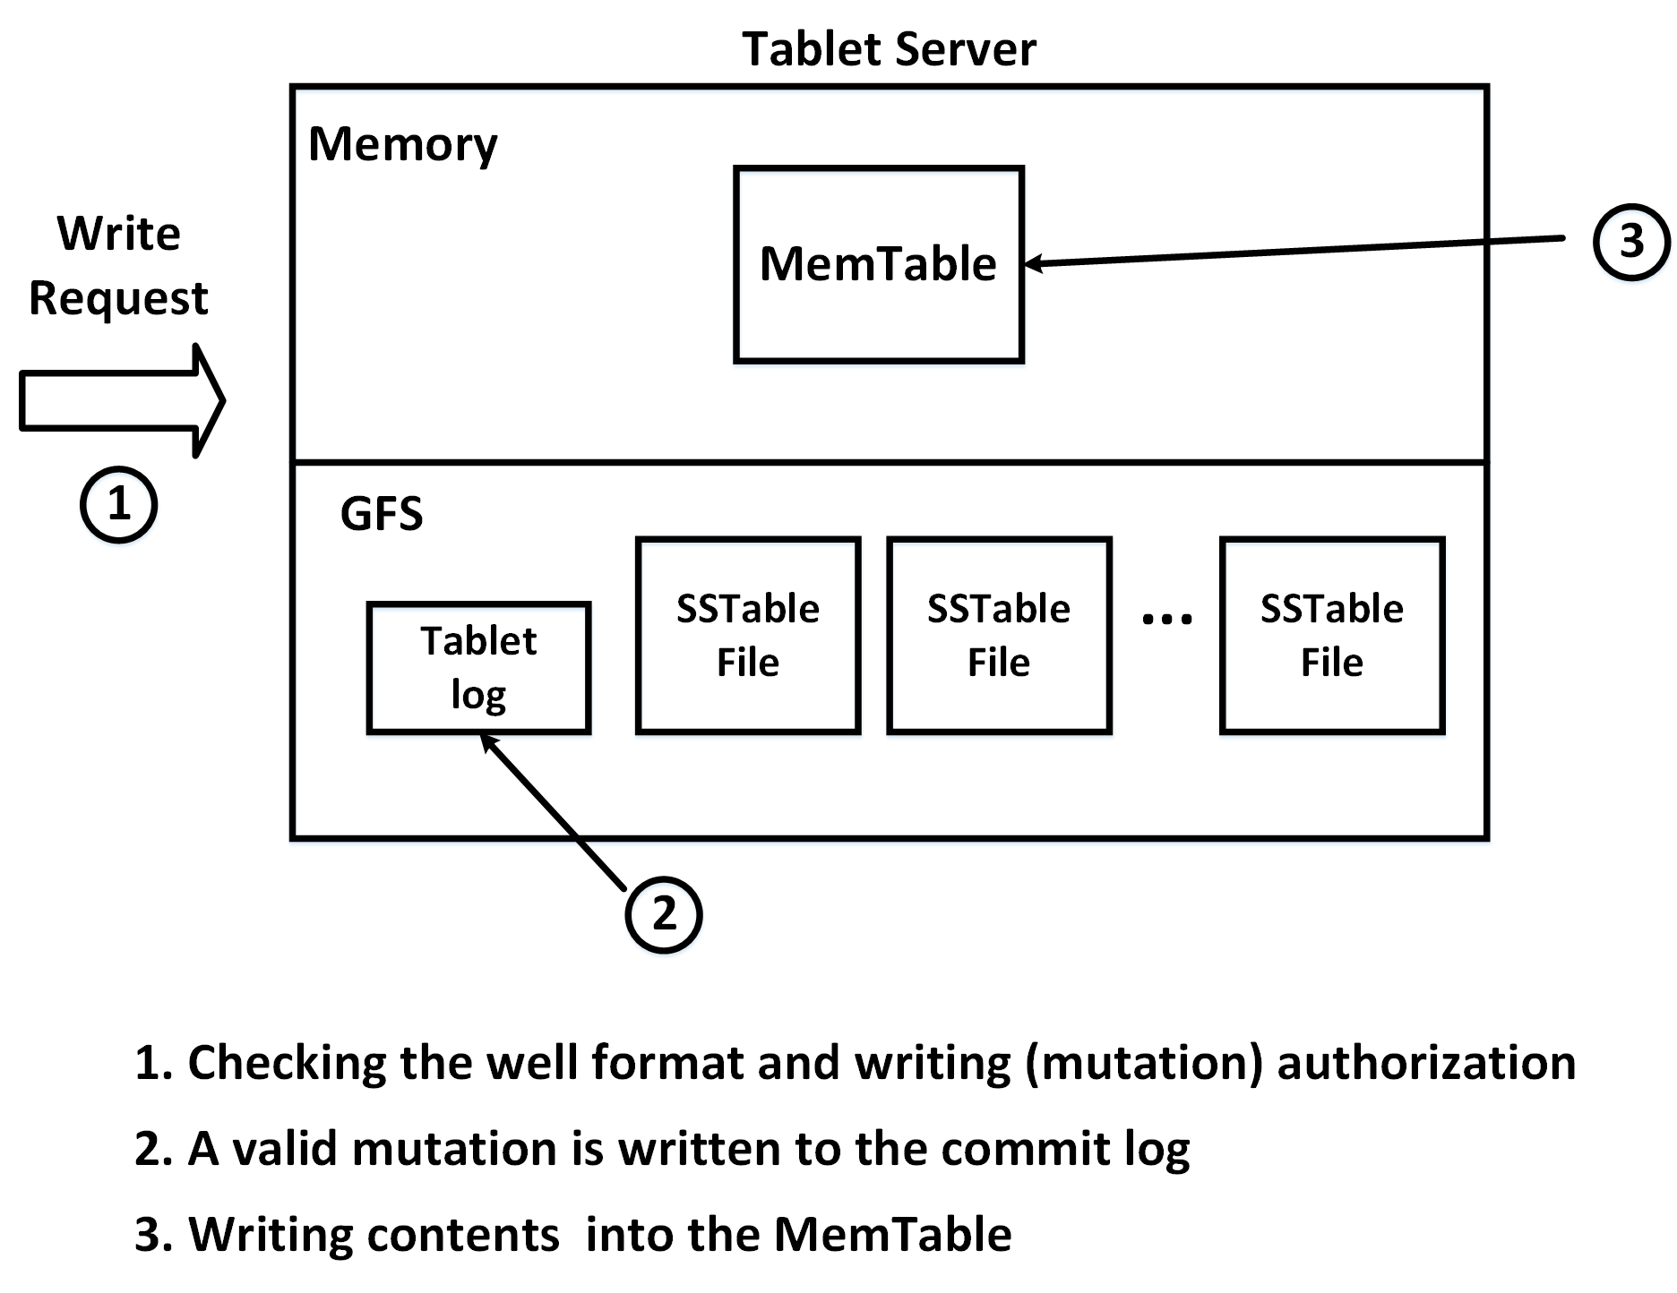
Tablet data writing
Notes:
1. 中文微軟正黑體，英文為Calibri
2.標題字級：32置中
3.小標題字級：20
4.內文字級：16
5. 重點可以使用粗體
6.可依需求插入圖片及調整圖片大小
7.每頁皆依上下左右規範留白，規範邊限於編輯完成後即可刪除。

Slide 30
Load Balancing
Balancing workload and data volume.
If a certain tablet gets a spike of traffic, Bigtable splits the tablet in two, then moves one of the new tablets to another node.
Splitting busier/larger tablets in half and merges less-accessed/smaller tablets together.
Balancing tablets among tablet servers
  Computing the average number ave_tab of tablets among all table servers
  Computing the allowable number of tablets in the range [ave_tab*(1-threshold), ave_tab*(1+threshold], threshold=0.2
  Moving out the excess number of tablets from the tablet servers with more than range upper bound to the tablet servers with less than range lower bound.
  Repeating the above steps at next load-balancing trigger time (e.g. 5 mins)
Notes:
1. 中文微軟正黑體，英文為Calibri
2.標題字級：32置中
3.小標題字級：20
4.內文字級：16
5. 重點可以使用粗體
6.可依需求插入圖片及調整圖片大小
7.每頁皆依上下左右規範留白，規範邊限於編輯完成後即可刪除。

Slide 31
References
[1] T. White, Hadoop: The Definitive Guide, 3rd ed. Sebastopol, CA, USA: O’Reilly Media, 2012.
[2] (2019). Hadoop Distributed File System. [Online].Available: http://limitedcode.blogspot.com/2014/10/hdfs-hadoop-distributed-file-system-hdfs.html
[3] K. Shvachko, H. Kuang, S. Radia and R. Chansler, “The Hadoop Distributed File System,” in Proc. IEEE 26th Symp. Mass Storage Systems and Technologies (MSST), Jun. 2010, pp. 1–10.
[4] S. Ghemawat, H. Gobioff and S.-T. Leung, “The Google File System,” in Proc. 19th ACM Symp. Operating Systems Principles, Dec. 2003, vol. 37, no. 5, pp. 29–43.
[5] F. Wang, J. Qiu, J. Yang, B. Dong, X. Li and Y. Li, “Hadoop High Availability through Metadata Replication,” in Proc. 1st Int. Workshop Cloud Data Manage, 2009, pp. 37–44.
[6] F. Chang, J. Dean, S. Et al, “Bigtable: A Distributed Storage System for Structured Data”, OSDI, 2006.
[7] (2012). BigTable Overview [Online]. Available: https://cloud.google.com/bigtable/docs/overview
[8] S. Ramanathan and S. Goel, “Comparison of Cloud database: Amazon's SimpleDB and Google's BigTable,” International Conference on Recent Trends in Information Systems, 2011, pp. 165- 168.
[9] S. Kalid, A. Syed, A. Mohammad and M. N. Halgamuge, “Big-data NoSQL databases: A comparison and analysis of “Big-Table”, “DynamoDB”, and “Cassandra”,” 2017 IEEE 2nd International Conference on Big Data Analysis (ICBDA), 2017, pp. 89-93.
[10] R. Chaudhary, G. S. Aujla, N. Kumar and J. J. P. C. Rodrigues, “Optimized Big Data Management across Multi-Cloud Data Centers: Software-Defined-Network-Based Analysis,” in IEEE Communications Magazine, Feb. 2018, vol. 56, no. 2, pp. 118-126.
Notes:
資料、圖片來源需文章中註明出處於章節最後編輯參考來源資料。

Slide 32
Reference
[11] Mike Burrows, “The Chubby lock service for loosely-coupled distributed systems,” in Proc. of the 7th OSDI, Nov. 2006.
Notes:
資料、圖片來源需文章中註明出處於章節最後編輯參考來源資料。

